Slide 1



Weather App
With extreme weather events such as floods becoming more frequent, we decided to create a Weather App that addresses the challenges faced by people in such situations.
by Meshack Mwalemba

Slide 2
We've Got You Covered
Transport Info
Weather Alerts
Get live updates on available transportation options in your area.
Receive real-time alerts for adverse weather conditions in your location.
User Reviews
Community Support
Read feedback from other users to help you make informed decisions.
Get help and advice from a community of people experiencing similar weather events.

Slide 3

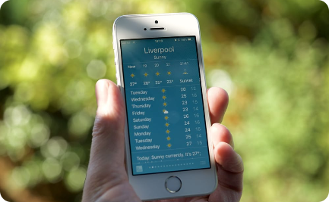

Advanced Search Capabilities
Location-based Search
User-friendly Interface
Real-time Updates
Find weather and transport information for your specific location, including surrounding areas.
Easily and quickly navigate through the app's features and functions.
Get the latest information as it becomes available, so you never miss a beat.

Slide 4
The Payment System
Secure Payment
Multiple Options
No Additional Fees
Our payment system is fully secure and your details will always be kept safe.
We accept a range of payment methods including credit and debit card, Paypal and mobile money.
We don't charge any hidden fees or transaction costs so you only pay for what you use.

Slide 5
Our Business Model
1
Launch of App
We will release our app in the App Store and Google Play Store.
Partnering with Businesses
2
We will partner with businesses to offer users discount vouchers and deals.
3
Premium Service
We will introduce a premium service where users can access more advanced features for a monthly fee.

Slide 6

Meet the Team
We are a team of experienced developers and designers who share a vision of making a difference through technology. We are passionate about using our skills to help people.
1
Meshack Mwalemba
2
Annabel Sanchez
3
John Kimani
Head of Design
Lead Developer
Founder & CEO

Slide 7

Ask Support Page
If you have any questions or problems with our app, please visit our support page. Our team is always available to help you.

Slide 8
Contact Us
Email
Phone Number
meshackmwalemba14@gmail.com
0627109582

Slide 9

Thank You for Your Time
We appreciate the opportunity to share our vision with you, and we look forward to providing our services to help you navigate extreme weather events and stay safe.

